Slide 1
Managing Ethical and Social Responsibility Challenges
in Multinational Companies
耿延

Slide 2
Learning Objectives (1 of 2)
Understand what international business ethics and social responsibility mean in business practice.
Understand some basic principles of ethical philosophy relevant to business ethics.
Understand how social institutions and national culture affect ethical decision making and management.
Understand the implications of using ethical relativism and ethical universalism in ethics management.

Slide 3
Learning Objectives (2 of 2)
Identify the basic principles and consequences of the U.S. Foreign Corrupt Practices Act.
Understand how international agreements affect international business ethics.
Understand the differences among economic, legal, and ethical analyses of business problems
Develop skills in international decision making with ethical consequences.

Slide 4
Ethical Challenges Facing MNCs Worldwide
Every Multinational company faces ethical challenges when operating in a foreign country:
  Should we dump our waste in the river knowing the damage it will do, even if such conduct is not illegal?
  Should we refuse to bribe a government official, and lose the contract to our competitor?
  Should we use cheap child labor, even if its not illegal, just because our competitors do?

Slide 5
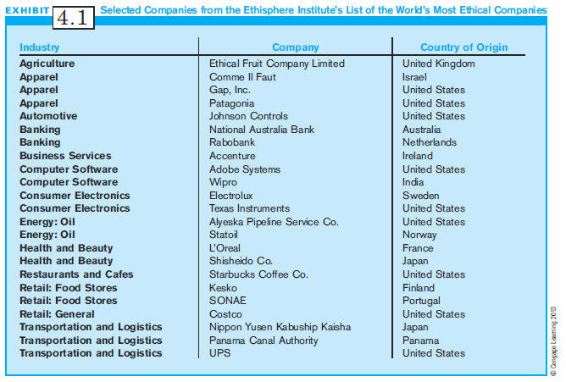
Exhibit 4.1:
List of the World’s Most Ethical Companies

Slide 6
What is Business Ethics?
Business Ethics: A part of the broader concern for ethical behavior, which affects people and their welfare
Ethics deal with the “shoulds” of life – the rules and values that determine actions people should follow when dealing with other human beings.
Although economic logic dominates business decision making, each business decision also has consequences for people, whether intended or not.
But ethical questions seldom have clear or unambiguous answers.

Slide 7
What is
International Business Ethics?
International Business Ethics: unique ethical problems faced by managers operating across national boundaries.
International business ethics differs from domestic business ethics in two ways:
  International business is more complex, as different cultures do not agree on what one “should” do.
  MNCs often have power and assets that are equal to foreign governments, raising more ethical concerns over the use of such power.

Slide 8
What is
Corporate Social Responsibility?
Corporate Social Responsibility (CSR): the idea that businesses have a responsibility to society beyond making profits
CSR is closely related to business ethics.
CSR is concerned with ethical consequences of company policies and procedures.
Practicing CSR, a business must take into account the welfare of other constituents in addition to stockholders.

Slide 9
Primary and Secondary Stakeholders
Primary Stakeholders:
  those who are directly linked to a company’s survival; (i.e., customers, suppliers, employees, and shareholders)
Secondary Stakeholders:
  those who are less directly linked to the company’s survival, but have impact; these include the media, trade associations, and special-interest groups
Addressing the needs of both groups is critical.
  See Shell Oil in Nigeria, Monsanto’s biotechnology products

Slide 10
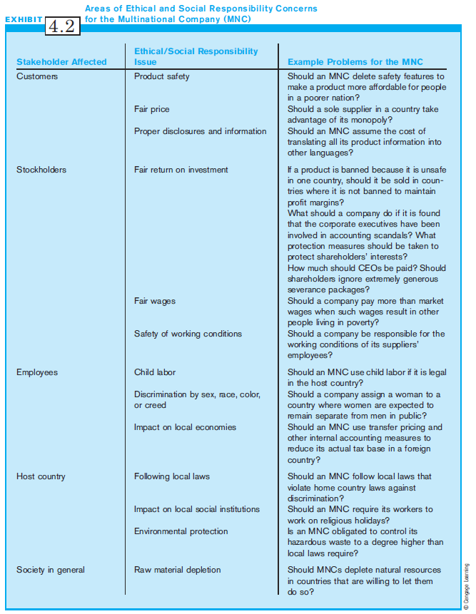
Exhibit 4.2:
Ethical & Social Responsibility Concerns for the MNC

Slide 11
Ethical Philosophy (1 of 2)
Two approaches to ethical decision making:
  Traditional Views
    Teleological ethical theories
      Morality of an act based on consequences
      Utilitarianism: greatest good for greatest number
    Deontological ethical theories
      Actions are good or bad in and of themselves
  Contemporary philosophy
    Moral Languages

Slide 12
Ethical Philosophy (2 of 2)
Moral Languages describe the basic ways that people think about ethical decisions and explain their ethical choices
Six basic ethical languages:
  Virtue and vice
  Self-control
  Maximizing human welfare
  Avoiding harm
  Rights and duties
  Social contract

Slide 13
National Differences in Business Ethics and Social Responsibility
National culture and social institutions affect how businesses manage ethical behavior and social responsibility.
  Cultural norms & values influence conformity to laws, and bribery, among others.
  Social institutions such as religion and the legal system are key institutions that affect what ethical issues are important to a society and how they are managed.
  Although there are differences between societies, some actions are universally condemned (i.e., harming children).

Slide 14
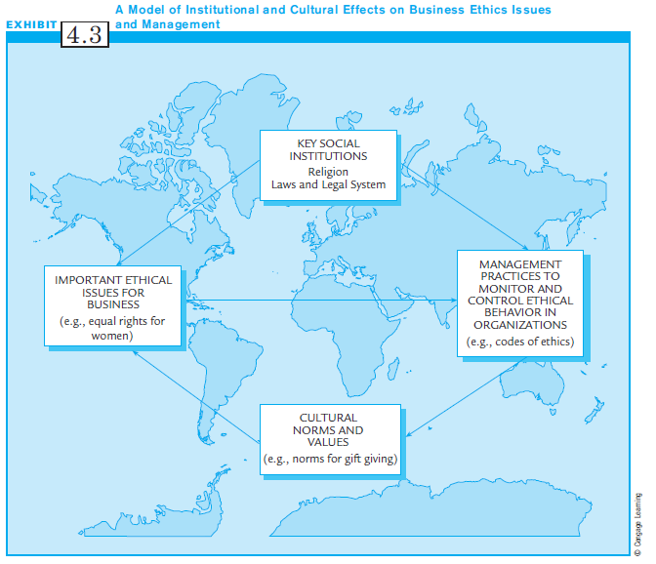
Exhibit 4.3:
A Model of Institutional & Cultural Effects on Business Ethics Issues & Management

Slide 15
Why Cultural Differences?
Institutional Anomie Theory and other research:
  Some national culture and social institutions are likely to encourage breaking norms, justifying ethically suspect behaviors.
  National cultures that value high achievement, high individualism, high universalism, high materialism are all related to higher deviance from norms.
  Social institutions such as high industrialization, capitalist systems, lower family breakdown, and highly accessible educational systems all encourage deviance from norms.

Slide 16
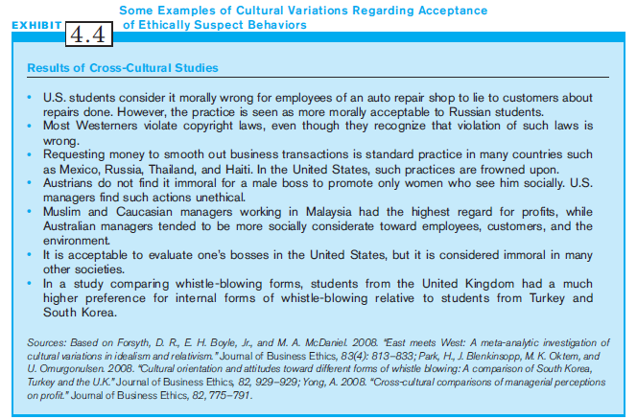
Exhibit 4.4:
Cultural Variations in Acceptance of Ethically Suspect Behaviors

Slide 17
Questionable Payments and Bribery
Questionable Payments are:
  Bribes or gifts to expedite government actions or to gain advantage in business deals
In many countries, such payments are expected, and people routinely offer gifts or bribes
Like the U.S., most countries have a law forbidding corrupt practices, but enforcement varies widely.

Slide 18
Implications:
Questionable Payments, Bribes
Corruption and bribery can have devastating effects on societies.
Companies routinely use poorer-quality products or materials to make up for the bribe, thus resulting in inferior products with poor quality.
Corruption can also result in collusion among firms, resulting in even higher prices.

Slide 19
Corruption Perception Index
To understand the level of corruption in countries, multinational companies can rely on the Corruption Perception Index (CPI).
CPI, developed by Transparency International, gives an idea of the perceived levels of corruption within countries.

Slide 20
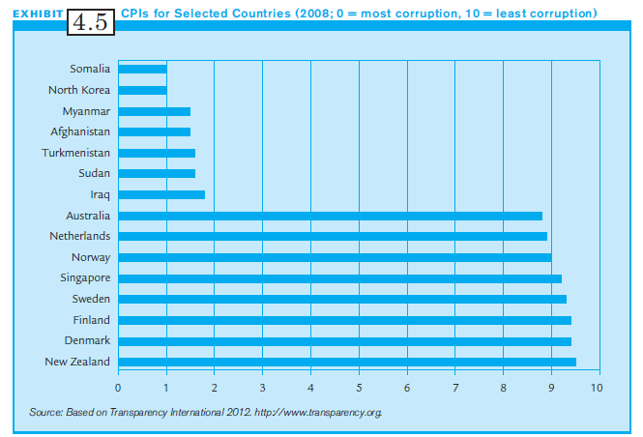
Exhibit 4.5:
The CPI for Selected Countries

Slide 21
U.S. Foreign Corrupt Practices Act (FCPA) (1 of 3)
The Foreign Corrupt Practices Act (FCPA) is the U.S. Law forbidding corrupt practices.
The FCPA forbids US companies from illegal payments or gifts to officials of foreign governments for the sake of getting or retaining business.
A firm may avoid liability if it has no “reason to know” that its agent has paid a bribe.

Slide 22
U.S. Foreign Corrupt Practices Act (FCPA) (2 of 3)
Tricky component is the “reason-to-know” component:
  Firms are liable for bribes if bribes are made by agents of the company.
  Firms often use local agents, as they have “local know how” in conducting business.
  Firms are liable if its common knowledge that agents bribe officials to commit illegal acts.
  If no knowledge or reason to expect illegal agent behavior, then firm is not held liable.

Slide 23
U.S. Foreign Corrupt Practices Act (FCPA) (3 of 3)
The FCPA does not prohibit some forms of payments that may occur in international business:
  Payments made under duress to avoid injury or violence
  Small payments to encourage officials to do legitimate and routine jobs
  Payments which are lawful in a country
  “Grease” payments which do not seek illegal ends, but are used to speed up normal business

Slide 24
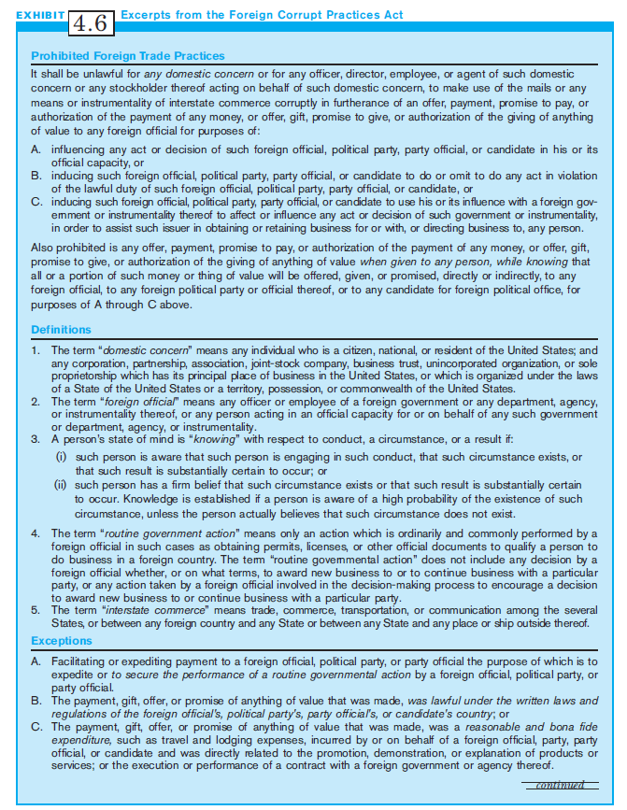
Exhibit 4.6:
Excerpts,
Foreign Corrupt Practices Act (1 of 2)

Slide 25
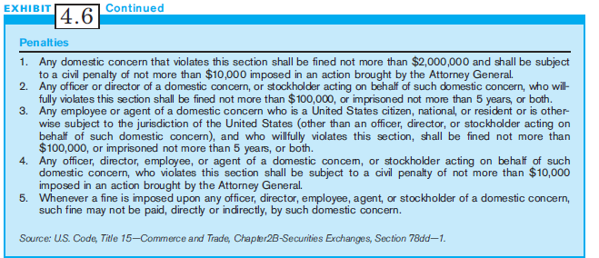
Exhibit 4.6:
Excerpts,
Foreign Corrupt Practices Act (2 of 2)

Slide 26
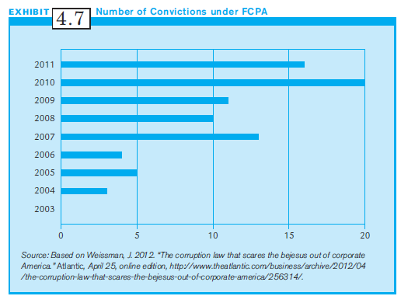
Exhibit 4.7:
FCPA: Number of Convictions

Slide 27
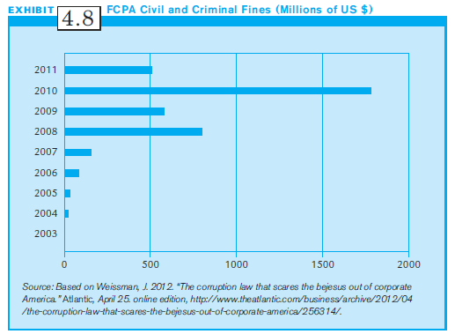
Exhibit 4.8:
FCPA: Civil & Criminal Fines

Slide 28
Toward Transnational Ethics
Globalization dramatically increases contact among people from different ethical and cultural systems.
This contact creates pressure for ethical convergence, and the development of transnational agreements among nations to govern business practices.
Despite differences in cultures, there are growing pressures to follow the same rules in managing ethical behavior and social responsibility.

Slide 29
Four Basic Reasons for Ethical Convergence
The growth of international trade and trading blocks
Interaction between trading partners which increases pressures to imitate business practices
Employees of varied cultural background who require common standards for conduct
An increasing number of business watchdogs

Slide 30
Prescriptive Ethics
Prescriptive Ethics: Suggested guidelines for the ethical behavior of MNCs
Three moral languages should guide MNCs:
  Avoiding harm
  Rights and duties
  Social contract
These three are the easiest to specify in written codes
Are also most appropriate in heterogeneous cultures

Slide 31
Sources of International Ethics Guidelines (1 of 2)
The United Nations Universal Declaration of Human Rights
The United Nations Code of Conduct on Transnational Corporations
The European Convention on Human Rights
The International Chamber of Commerce Guidelines for International Investment

Slide 32
Sources of International Ethics Guidelines (2 of 2)
The Organization for Economic Cooperation and Development Guidelines for Multinational Enterprises
The Helsinki Final Act
The International Labor Office Tripartite Declarations of Principles Concerning Multinational Enterprises and Social Policy
These may be sources for the Code of Conduct for the Multinational Company.

Slide 33
Code of Conduct for the Multinational
Two basic rationales:
  Basic deontological principles dealing with human rights (such as the right to work, right to be safe)
  History of experiences in international business interactions (MNCs often ignore the environment)
However, despite agreements, MNCs may not always follow ethical principles.
Even if such Codes are not enforceable, they provide a safe guide to ethical conduct for management.

Slide 34
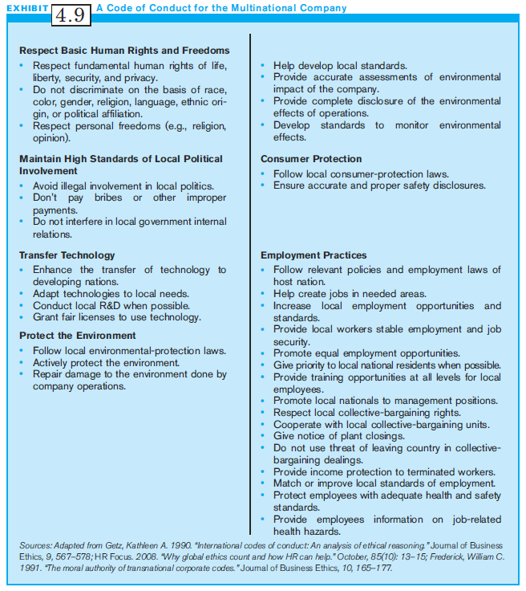
Exhibit 4.9:
A Code of Conduct for the Multinational Company

Slide 35
The Ethical Dilemma in Multinational Management:
How Will You Decide?
Ethical relatiHerevism vs. Ethical universalism
  Ethical relativism: Each society’s view of ethics must be considered legitimate and ethical. (When in Rome…)
  Ethical universalism: Basic moral principles transcend cultural and national boundaries
Difficulty in following either standard
Ethical relativism can become convenient relativism.

Slide 36
Convenient Relativism;
Extreme Moral Universalism
Convenient Relativism occurs when companies use the logic of ethical relativism to behave any way they please, using differences in cultures as an excuse.
Similarly, extreme moral universalism can lead to problems of cultural imperialism in which managers assume they know the correct and ethical ways of behaving, viewing other values as inferior.

Slide 37
Individual Ethical Decision Making for the Multinational Manager
Forms of analyses:
  Economic analysis: focuses on what is the best decision for a company’s profits
  Legal analysis: focuses on only meeting legal requirements of host and parent countries
  Ethical analysis: goes beyond focusing on profit goals and legal regulations to consider what is the “right” thing to do.

Slide 38
For the MNC Manager:
Individual Ethical Decision Making
Ethical analysis has 3 components:
  One’s organization
  The national culture where the firm operates
  Personal ethical beliefs
Purely ethical issues must be weighed against economic and legal analyses.
MNCs are guests in other nations, and their actions will impact their host country and its inhabitants.

Slide 39
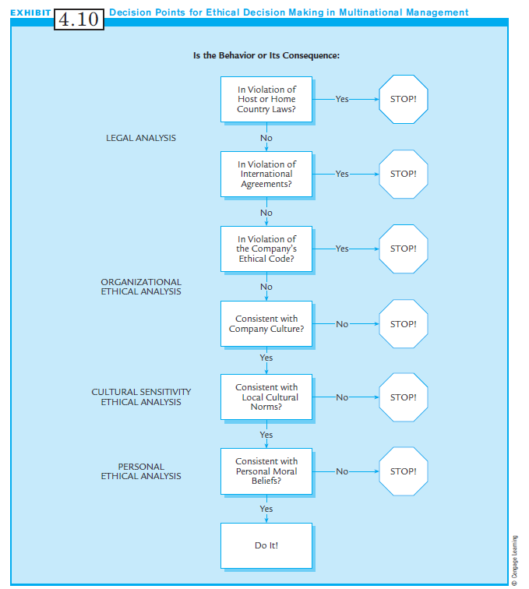
Exhibit 4.10:
Decision Points for Ethical Decision Making in Multinational Management

Slide 40
Summary
The background on business ethics are provided.
Multinational managers face ethical dilemmas similar to their domestic counterparts.
Challenges are magnified by the complexity of working across different countries and cultures.
National contexts influence ethics in organizations.
Despite some convergence, ethical differences exist.
The individual MNC manager must decide.

